Slide 1
NodeJs-Rest Apis

Slide 2
Agenda
Introduction to REST basics.
Stateless vs Statefull
HTTP methods
RESTFul Web Services
Request and Response
Building simple hello application with plain node.

Slide 3
What Is REST?
REST stands for REpresentational State Transfer.
REST is web standards based architecture and uses HTTP Protocol. It revolves around resource where every component is a resource and a resource is accessed by a common interface using HTTP standard methods.
A REST Server simply provides access to resources and REST client accesses and modifies the resources using HTTP protocol.

Slide 4
Why REST
Scalability
General practice
Technology Independence
Security
Encapsulation

Slide 5
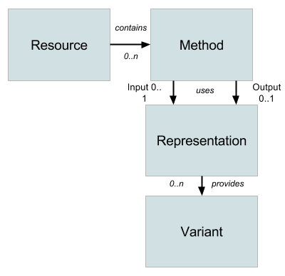
Elements of REST Model

Slide 6
Resource
The central element of REST
A resource is an object with a type, associated data, relationships to other resources, and a set of methods that operate on it.
A resource can be of many types:
A resource to get the list of elements of this kind and to add new ones.
Another to manage a particular element of this kind.
And resources that manage no state and provide specific processing logic.

Slide 7
Methods
A predefined set of methods that get/update/delete a resource.
They are usually represented by a verb. eg:-
GET
POST
PUT
DELETE
PATCH

Slide 8
Representation
Structure of exchanged data
Different Method use different representation of same resource
For eg. Representation of PATCH might vary from PUT but both the call update the same resource.

Slide 9
Variant
Format in which data is exchanged. Example
JSON
XML
YAML

Slide 10
Resource URL
A resource is attached to a URL in order to make it accessible from the Web.
This URL is known as Resource path.
They can be hierarchical, and this aspect can help us define relationships between managed entities.
There are several ways to send parameters to resources
As a path variable:
/myentity/{entityid}
/user/{userid}/version/{versionid}
As a query parameter:
what is specified after the ? within a URL

Slide 11
Stateless vs Statefull
A stateless system can be seen as a box [black? ;)] where at any point in time the value of the output(s) depends only on the value of the input(s) [after a certain processing time]
A stateful system instead can be seen as a box where at any point in time the value of the output(s) depends on the value of the input(s) and of an internal state, so basicaly a stateful system is like a state machine with "memory" as the same set of input(s) value can generate different output(s) depending on the previous input(s) received by the system.

Slide 12
HTTP methods
Following four HTTP methods are commonly used in REST based architecture.
GET − This is used to provide a read only access to a resource.
POST − This is used to create a new resource.
DELETE − This is used to remove a resource.
PUT − This is used to update a existing resource or create a new resource.

Slide 13
HTTP methods - GET
For retrieving the information
Must be safe and idempotent
For Collection Resource, /mobiles
It fetches all the element of that entity
For Instance Resource, /mobile/{mobileId}
It fetches a single element of that resource
Note: An idempotent method is a HTTP method that can be called many times without different outcomes. It would not matter if the method is called only once, or ten times over. The result should be the same. Safe method does not change the state or representation of resources

Slide 14
HTTP methods - GET
Can you guess the result for the following:
/mobiles
/mobiles/ab231
/mobiles/ab231/variations
Complex Queries
/mobiles?variant=iphone&screenSize=5

Slide 15
HTTP methods - DELETE
For deleting an instance of resource identified by the URL
DELETE operations are idempotent. Example:
DELETE http://www.example.com/customers/12345
DELETE http://www.example.com/customers/12345/orders
DELETE http://www.example.com/bucket/sample

Slide 16
HTTP methods - POST
For creating a new Resource
Can be used to create subordinate resources as well
POST is neither safe nor idempotent.
Making two identical POST requests will most-likely result in two resources containing the same information.
By convention, it should be ideally available to collection resources. Eg:-
POST http://www.example.com/customers
{'firstName': “Prashant”, 'lastName': “Sharma”, “age”:25}
POST http://www.example.com/customers/12345/orders
{'product':'ball', 'quantity': 2}

Slide 17
HTTP methods - PUT
For updating resource mentioned in URL
PUT is not a safe operation, in that it modifies state on the server, but it is idempotent
By convention, we provide the complete representation of the resource in PUT with updated data
Examples
PUT http://www.example.com/customers/12345
{'firstName': “Gaurav”, 'lastName': “Sharma”, “age”:29}
PUT http://www.example.com/customers/12345/orders/98765
{'product':'ball', 'quantity': 5}

Slide 18
HTTP methods - PATCH
Same as PUT. By convention, we provide only the updated information in the PATCH call. Eg
PATCH http://www.example.com/customers/12345
{'firstName': “Gaurav”, “age”:29}
PATCH http://www.example.com/customers/12345/orders/98765
{'quantity': 5}

Slide 19
RESTFul Web Services
A web service is a collection of open protocols and standards used for exchanging data between applications or systems. Software applications written in various programming languages and running on various platforms can use web services to exchange data over computer networks like the Internet in a manner similar to inter-process communication on a single computer. This interoperability (e.g., communication between Java and Python, or Windows and Linux applications) is due to the use of open standards.
Web services based on REST Architecture are known as RESTful web services. These webservices uses HTTP methods to implement the concept of REST architecture. A RESTful web service usually defines a URI, Uniform Resource Identifier a service, which provides resource representation such as JSON and set of HTTP Methods.

Slide 20
Response
When a response comes back, there are two pieces of information to consider:
HTTP Status code - this tells you at a protocol level what the status of the response is.
Response Payload - this is the body of the response. It is in a standard format that will give you the application level status, the results, and if applicable, any errors.

Slide 21
Response Codes
4xx Client Error
400 Bad Request
401 Unauthorized
403 Forbidden
404 Not Found
2xx Successful
200 success/OK
201 created
204 no content
5xx Server Error
500 Server Error
502 Bad Gateway
503 Unavailable

Slide 22
Response - POST
Collection URL, /customers
Success : 201 (Created)
Failure : 409 (Conflict)

Slide 23
Response - GET
Collection URL, /customers
Success : 200 (OK) [list of customers]
Instance URL, /customers/{id}
Success : 200 (OK) [single customer data]
Failure : 404 (Not Found) [Id not found or invalid]

Slide 24
Response - PUT
Collection URL, /customers
Failure : 404 (Not Found)
Instance URL, /customers/{id}
Success : 200 (OK), 204 (No Content)
Failure : 404 (Not Found) [Id not found or invalid]

Slide 25
Response - DELETE
Collection URL, /customers
Failure : 404 (Not Found)
Instance URL, /customers/{id}
Success : 200 (OK)
Failure : 404 (Not Found) [Id not found or invalid]

Slide 26
Request
The req object represents the HTTPrequest and has properties for the request query string, parameters, body, HTTP headers, and so on.
Following is the list of few properties associated with request object.
req.baseUrl:- The URL path on which a router instance was mounted.
req.body:- Contains key-value pairs of data submitted in the request body.
req.query:- An object containing a property for each query string parameter in the route.

Slide 27
Exercises
Create a REST API for User entity with following fields:
Username
Password
FirstName
LastName
Create search bar which will search by user name and will create an autocomplete list of user which fulfil the criteria.
2. Create a student API which will return list of all students.
Create a table which will show all users
Create filter for student branch name and on clicking on filters it will show students accordingly.
3. Create header which will show following items
Home
About
Contact us
On clicking on the items it will load the pages

Slide 28
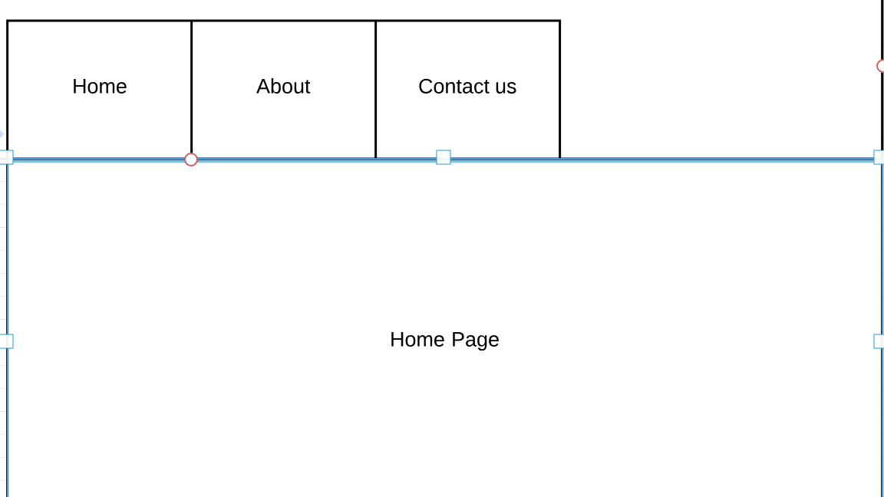

Slide 29


